Slide 1
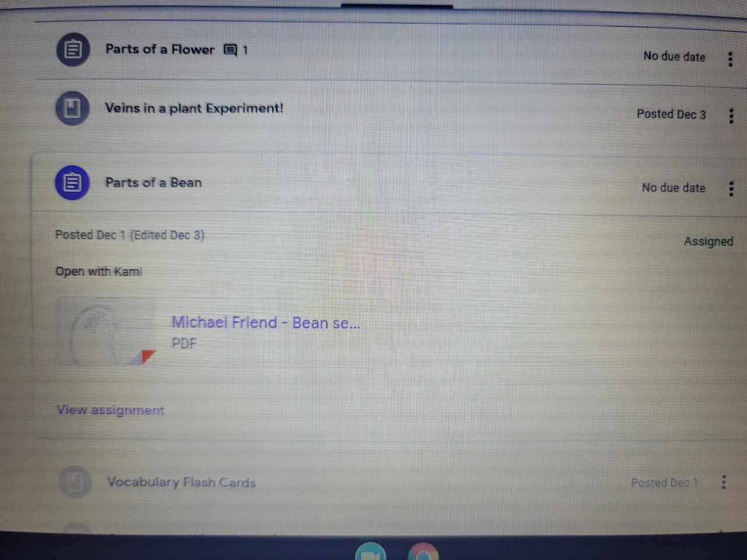
Step 1: Annotate with Kami.
Select the assignment you need to complete by going to the “CLASSWORK’ tab at the top of the screen. If the document is to be completed with Kami, the teacher will place a note to open it with Kami.

Slide 2
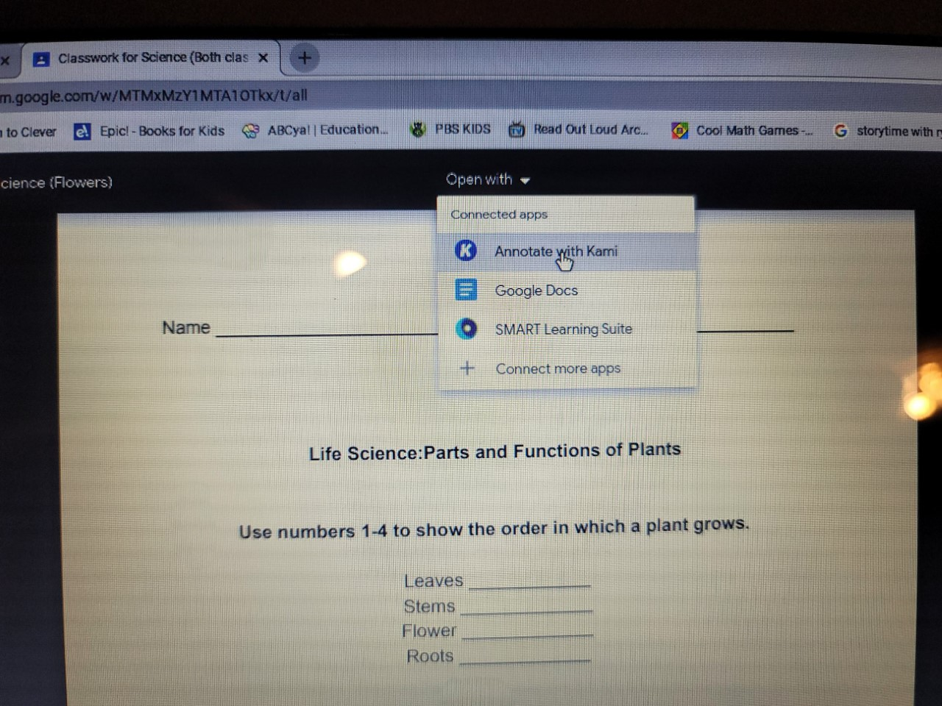
Step 2: Annotate with Kami
Open the document and at the top you will see the “OPEN WITH” icon. Click and select to annotate with Kami.

Slide 3
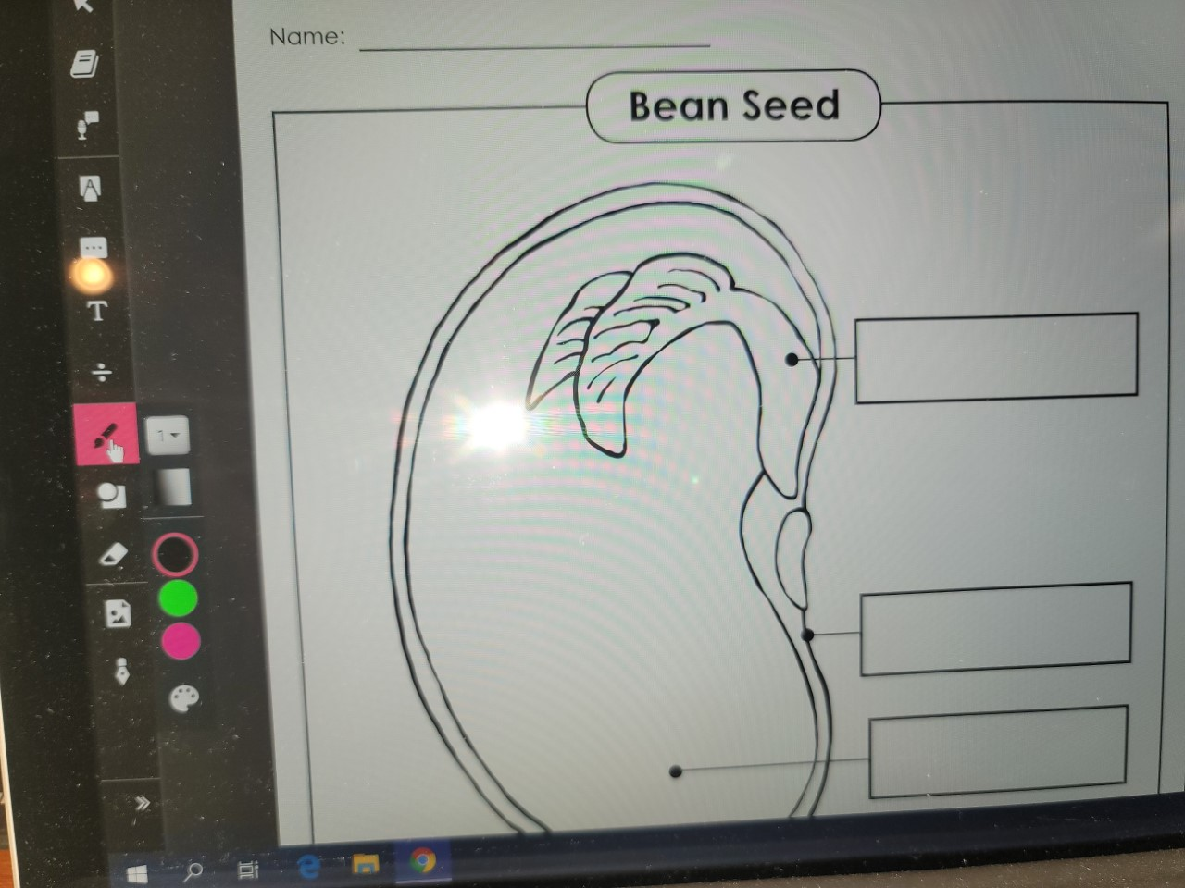
Step 3: Annotate with Kami
After opening with Kami, use the toolbar on the left side of the screen to complete the assignment.
Select “T” to create a box to enter text.
Select the math symbol to enter equations.
Select the paintbrush icon to color or draw
Select the circle/square icon to use shapes.

Slide 4
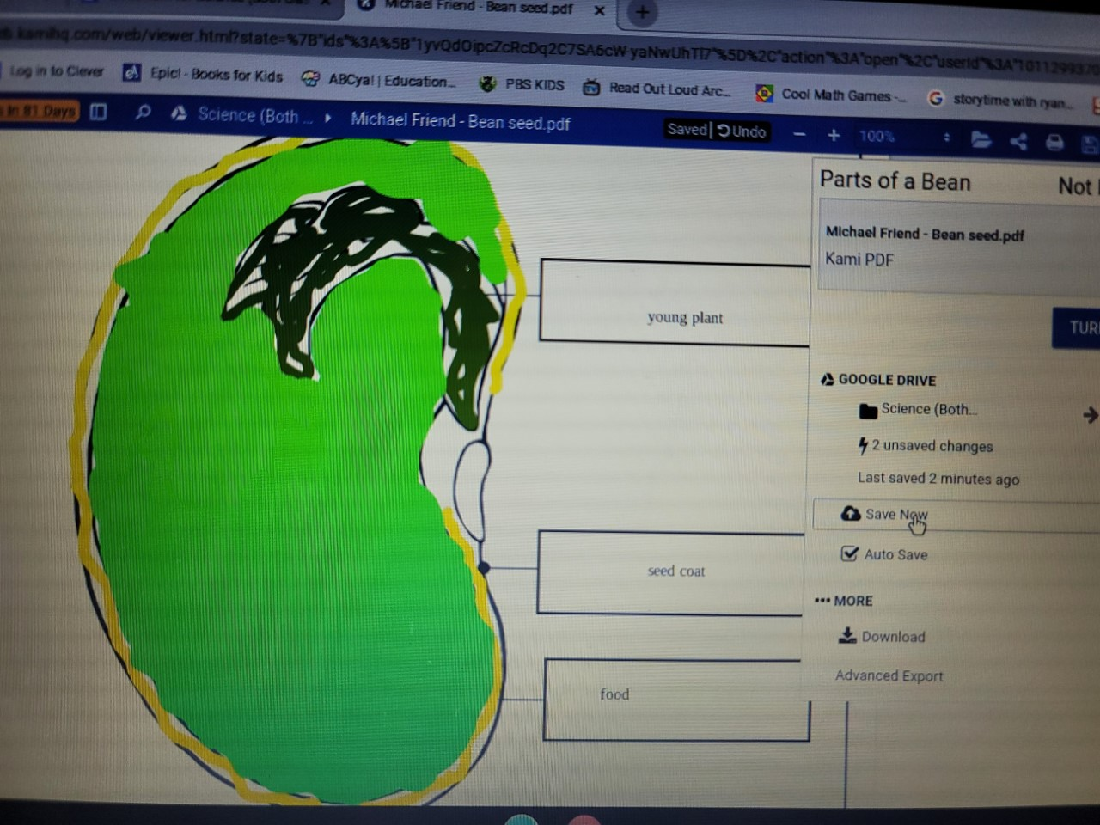
Step 4: Annotate with Kami
After annotating with Kami, click the turn in icon to open the menu bar, select SAVE NOW.
Close the Kami document.

Slide 5
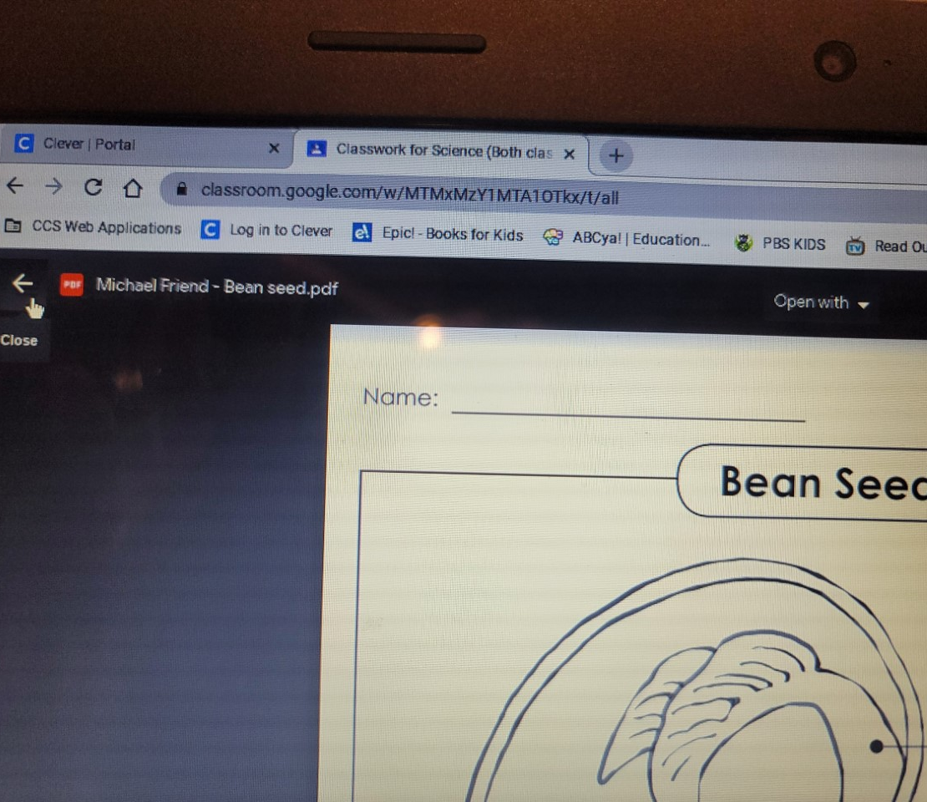
Step 5: Annotate with Kami
After closing the Kami document, you will return to the original document. Click the back arrow.

Slide 6
Step 6: Annotate with Kami
You will return to the assignment box. Click view assignment.

Slide 7
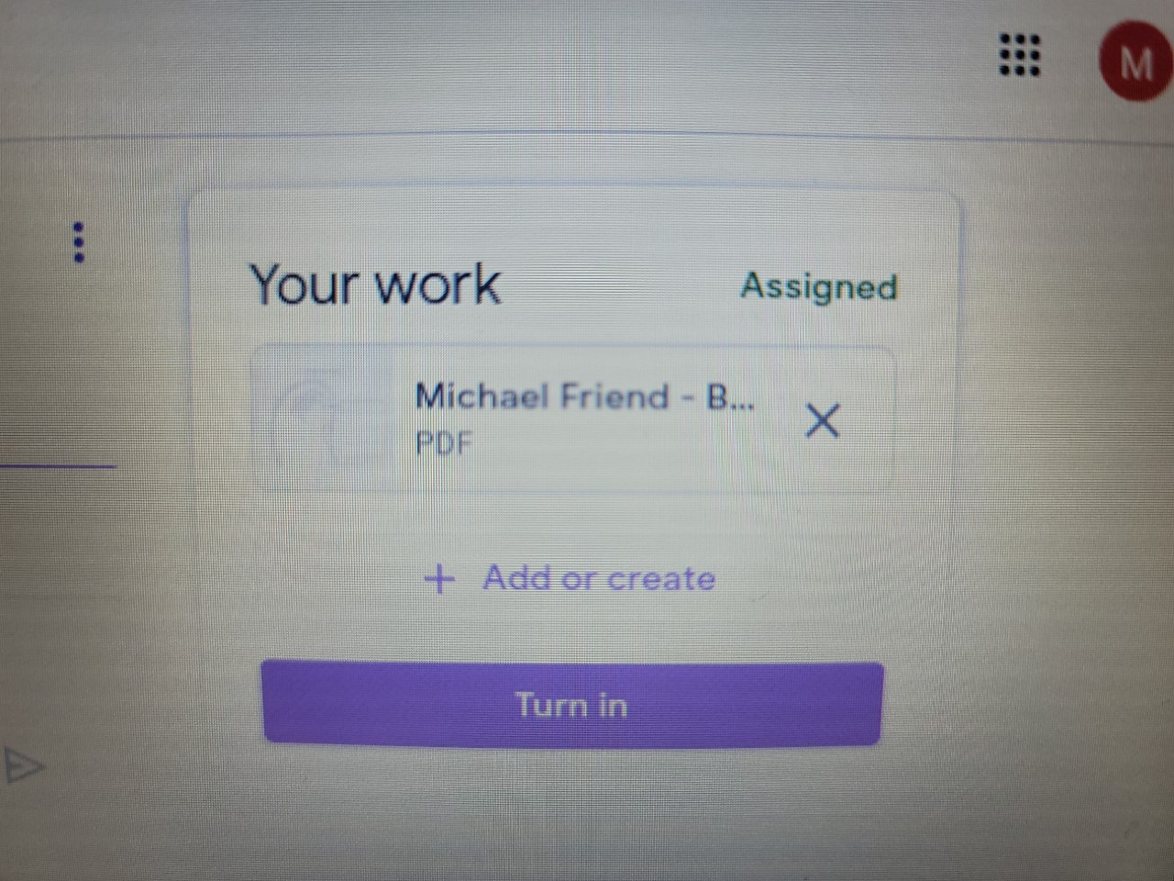
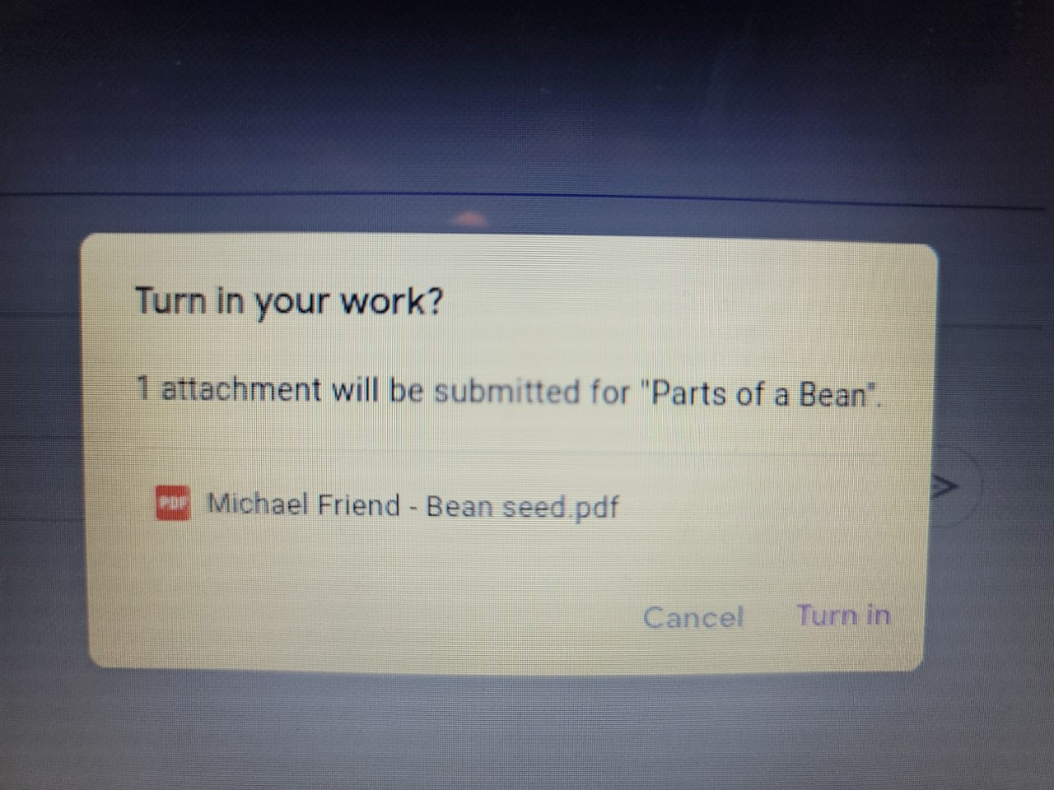
Step 7: Annotate with Kami
The completed document will show up in the your work box. Select the turn in icon.
You will see a 2nd box pop up that says
“Turn in your work?”
Click Turn in. The document is now submitted.

Slide 8
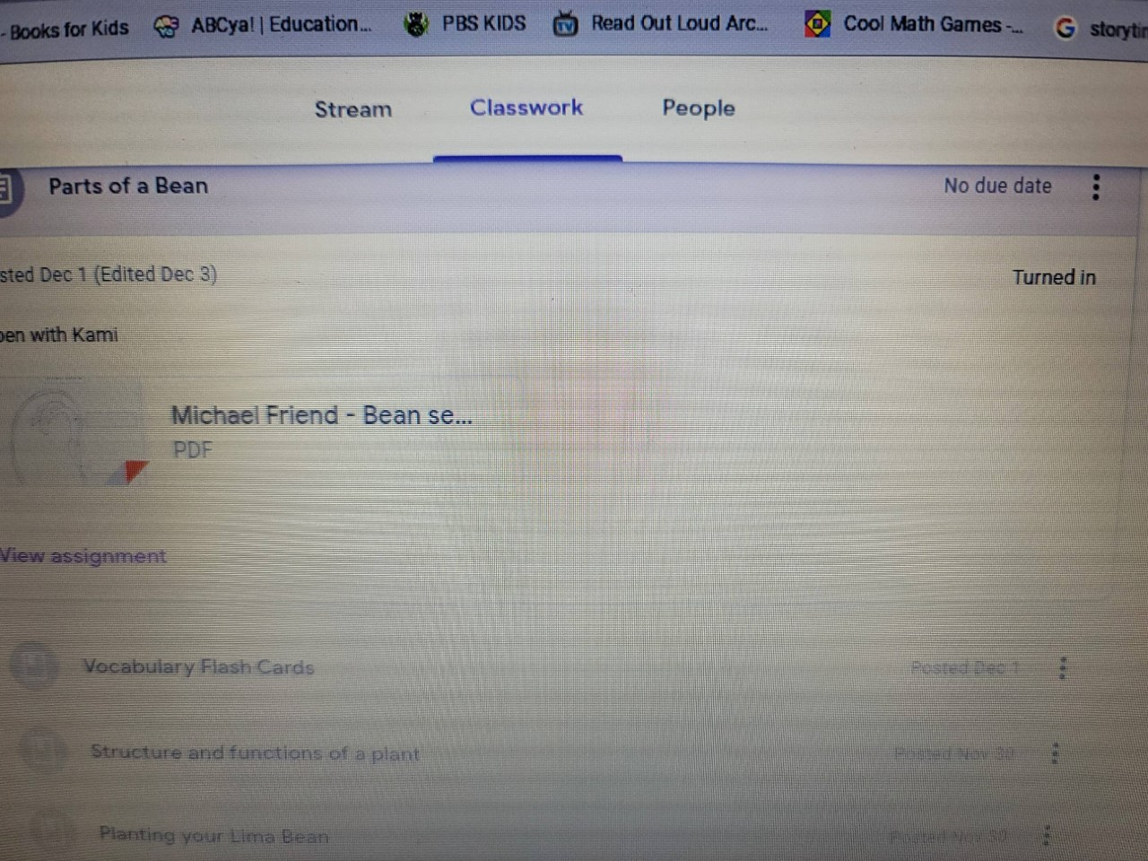
Step 8: Annotate with Kami
Once an assignment is turned in, you will be able to see in the assignment box that the assignment has been turned in.

Slide 9
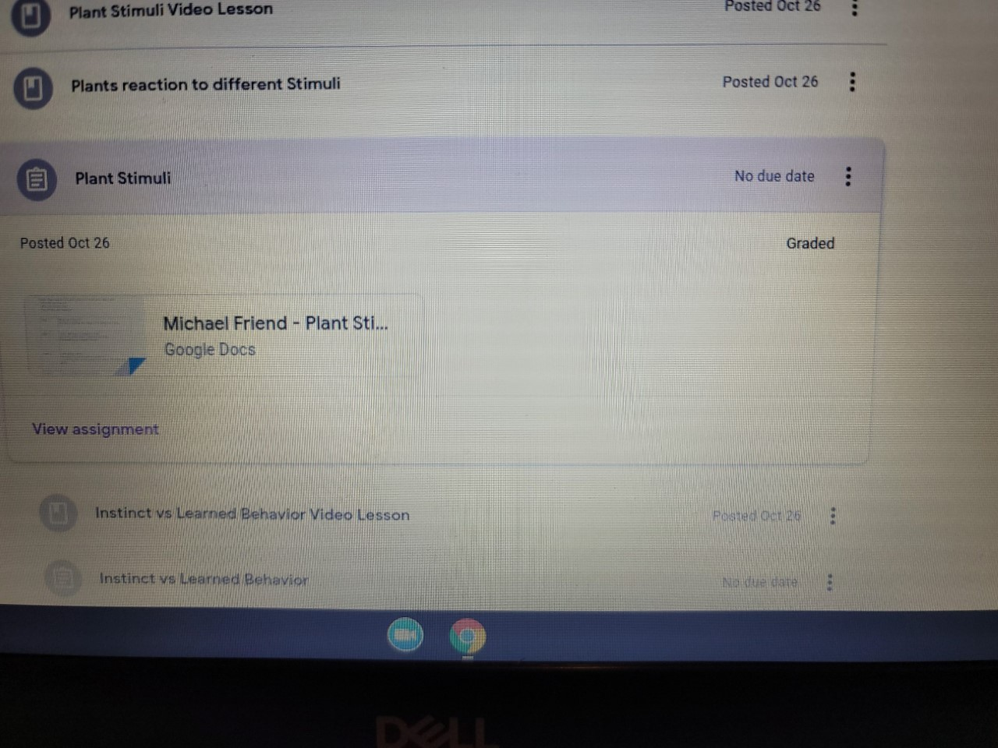
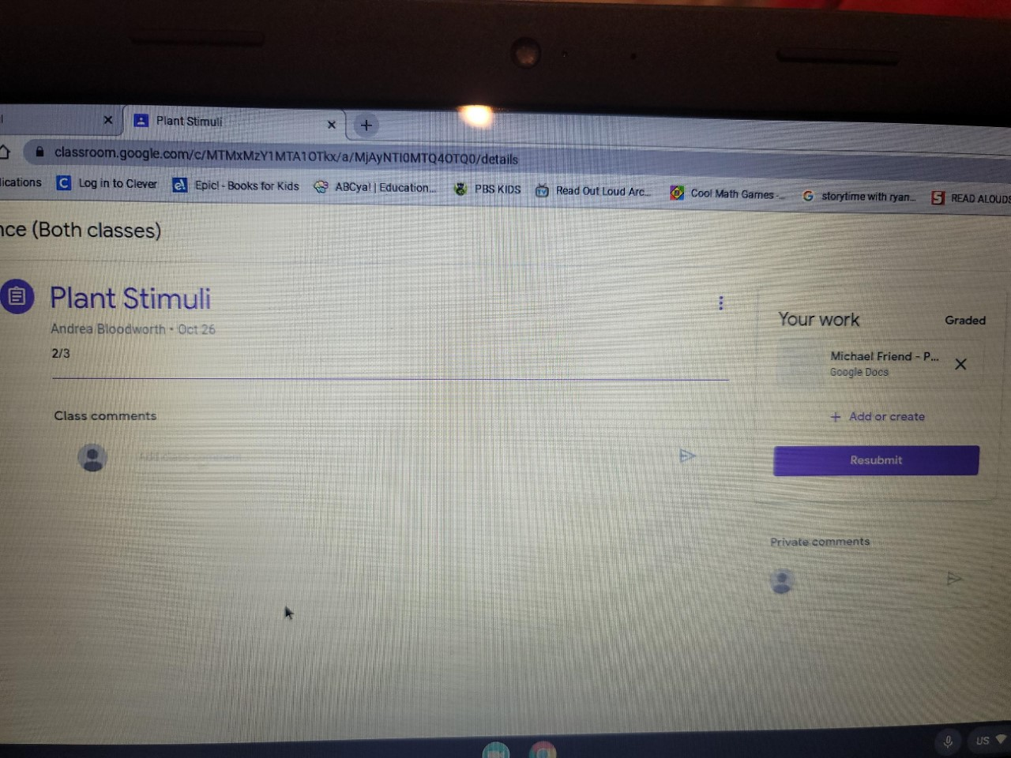
Step 9: Annotate with Kami
Once an assignment has been graded, it will show that it has been graded when you click on the assignment box.
If you click the view assignment box, you will be able to see the grade. To view the work, click on the document in the “Your work” box on the right side of the screen.

Slide 10
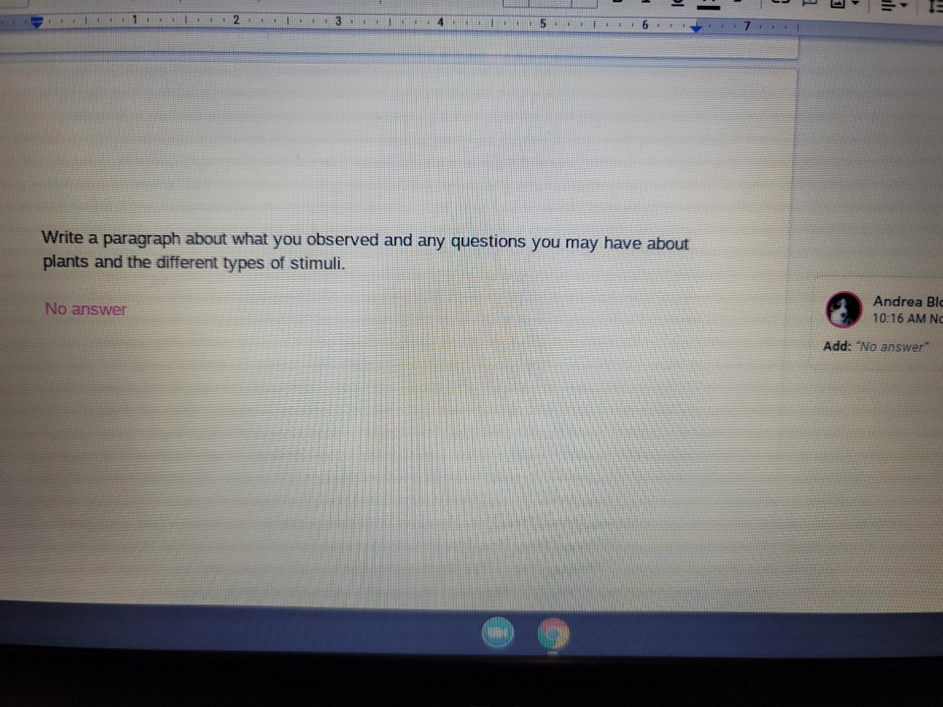
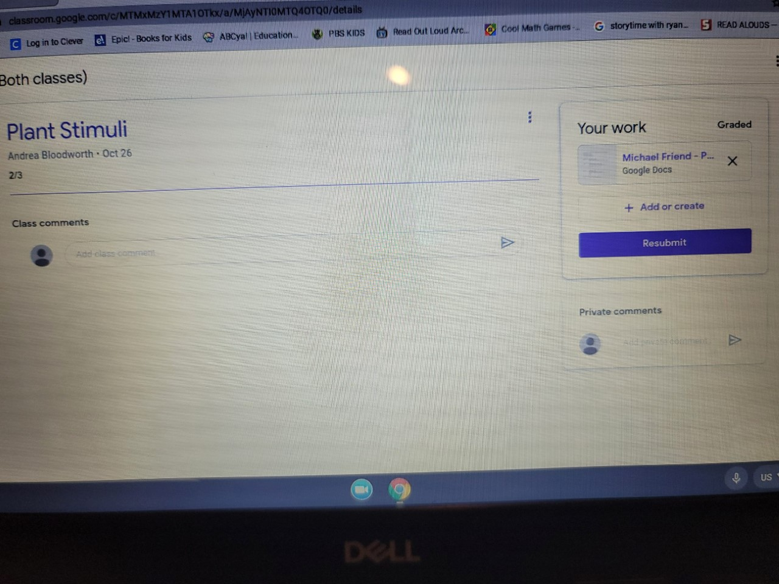
Step 10: Annotate with Kami
You will be able to see any comments and markups that the teacher has done.
Close the document and it will return to the assignment screen. Unless instructed to do so – DO NOT RESUBMIT GRADED WORK

